Slide 1
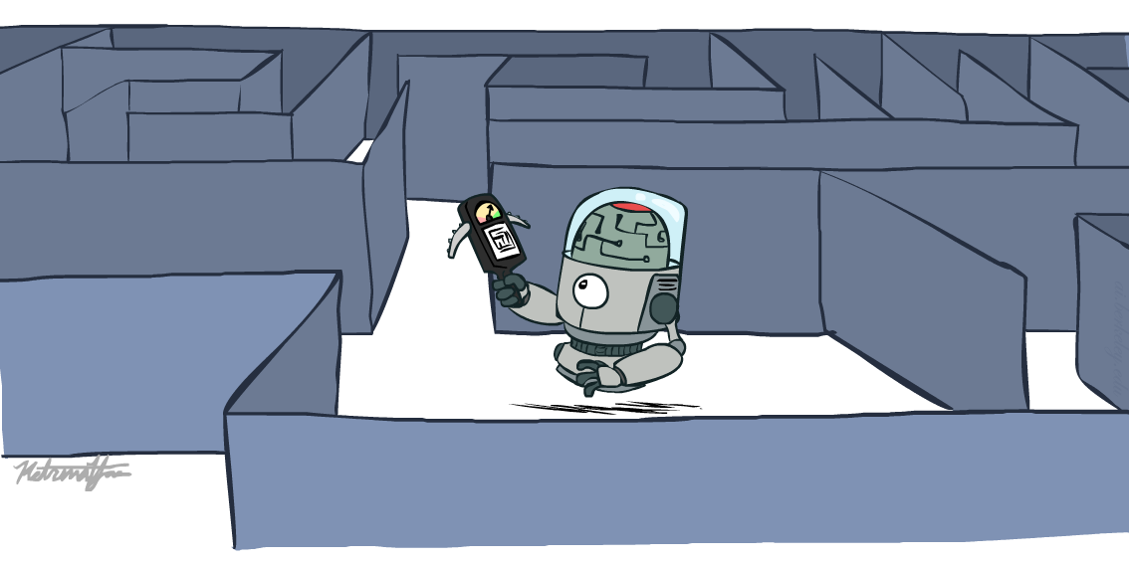
CS 188: Artificial Intelligence
Informed Search
Instructor: Malak Abdullah
Jordan University of Science and Technology
[slides adapted from University of California, Berkeley]
Notes:
Please retain proper attribution and the reference to ai.berkeley.edu. Thanks!

Slide 2
Example: route-finding in Romania

Slide 3
What we would like to have happen
Guide search towards the goal instead of all over the place
Informed
VS
Uninformed

Slide 4
BEST First Search
With best-first, node is selected for expansion based on evaluation function f(n).
Evaluation function is a cost estimate; expand lowest cost node first (same as uniform-cost search but we replace g with f).
Greedy Best First Search
A* Best First Search

Slide 5
Heuristic
Often, for best-first algorithms, f is defined in terms of a heuristic function, h(n).
h(n) = estimated cost of the cheapest path from the state at node n to a goal state. (for goal state: h(n)=0)
Heuristic functions are the most common form in which additional knowledge of the problem is passed to the search algorithm.

Slide 6
Remember
In the route planning example, the estimate of the cost of the cheapest path might be the straight-line distance between two cities.
g(n) = cost from the initial state to the current state n.
h(n) = estimated cost of the cheapest path from node n to a goal node.
f(n) = evaluation function to select a node for expansion (usually the lowest cost node).
Expand the node n with smallest f(n).

Slide 7
Informed Search ?!
Evaluation function f(n) = h(n) with Greedy First search
(heuristic), the estimate of cost from n to goal.
We use the straight-line distance heuristic:
h_{SLD}(n) = straight-line distance from n to Bucharest.
The heuristic values cannot be computed from the problem description itself!
We require extrinsic knowledge to understand that h_{SLD} is correlated with the actual road distances.

Slide 8
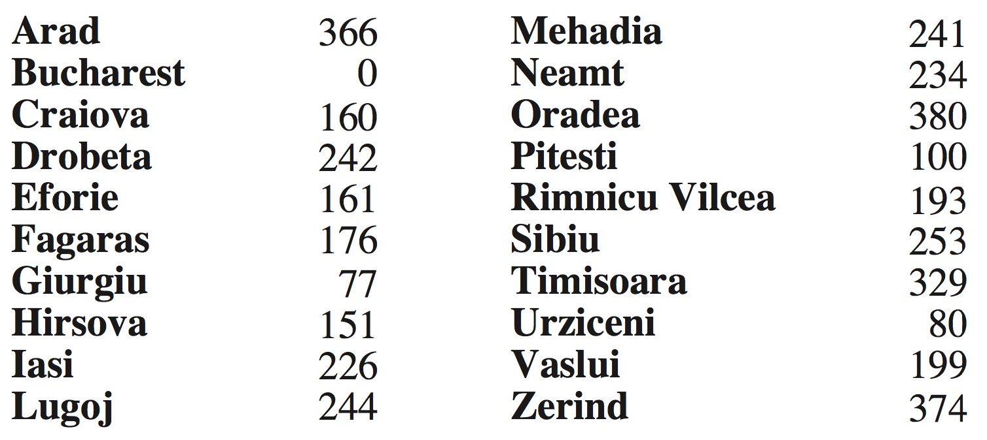
Example: route-finding in Romania
h(n) = straight-line distance to Bucharest

Slide 9

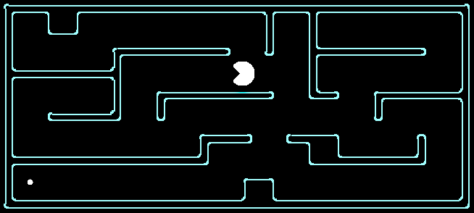

Example: pathing in Pacman
h(n) = Manhattan distance = |Δx| + |Δy|
Is Manhattan better than straight-line distance?
10
5
11.2

Slide 10
Greed Best First Search
The Greedy BFS algorithm selects the path which appears to be the best
It can be known as the combination of depth-first search and breadth-first search.
Greedy BFS makes use of Heuristic function and search and allows us to take advantages of both algorithms.

Slide 11
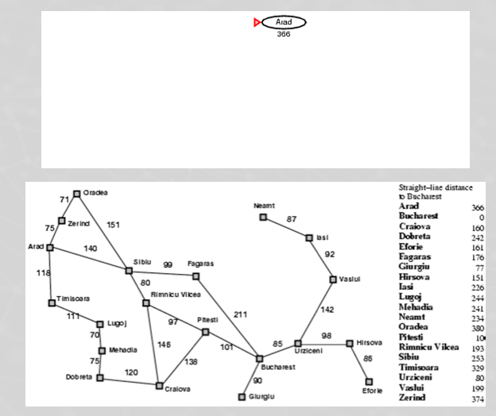
Greedy Best First Search Example
Uniform Cost Search
F(n)= g(n)
Greedy Best First Search
F(n)= h(n)
Arad g(n) h(n)
Zerlnd 75 374
Sibiu 140 253
Timisoara 118 329

Slide 12
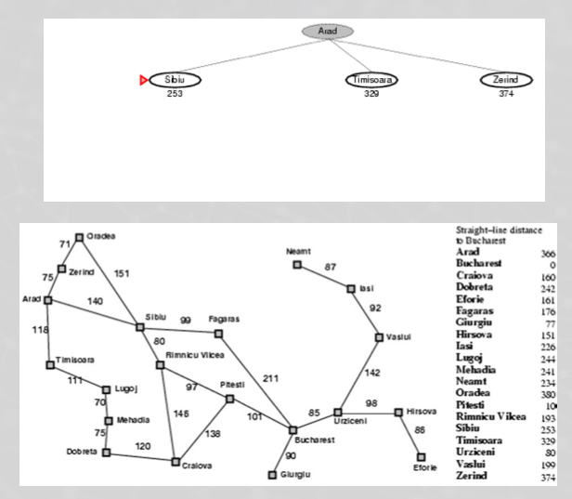
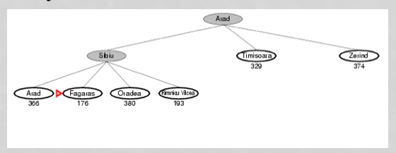
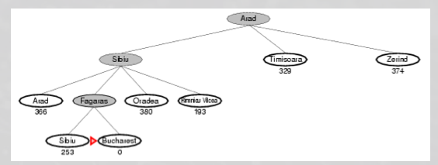
Greedy Best First Search
2
3
4

Slide 13
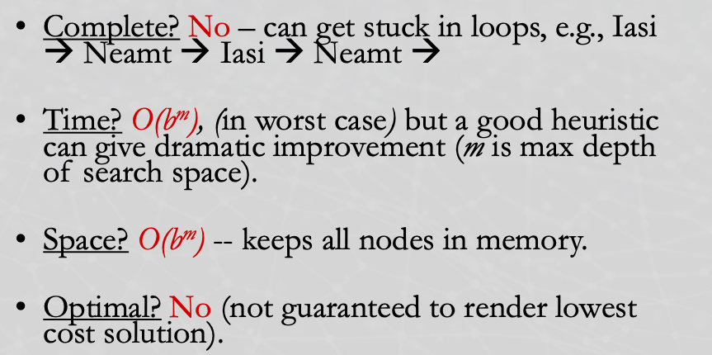
Properties of Greedy

Slide 14
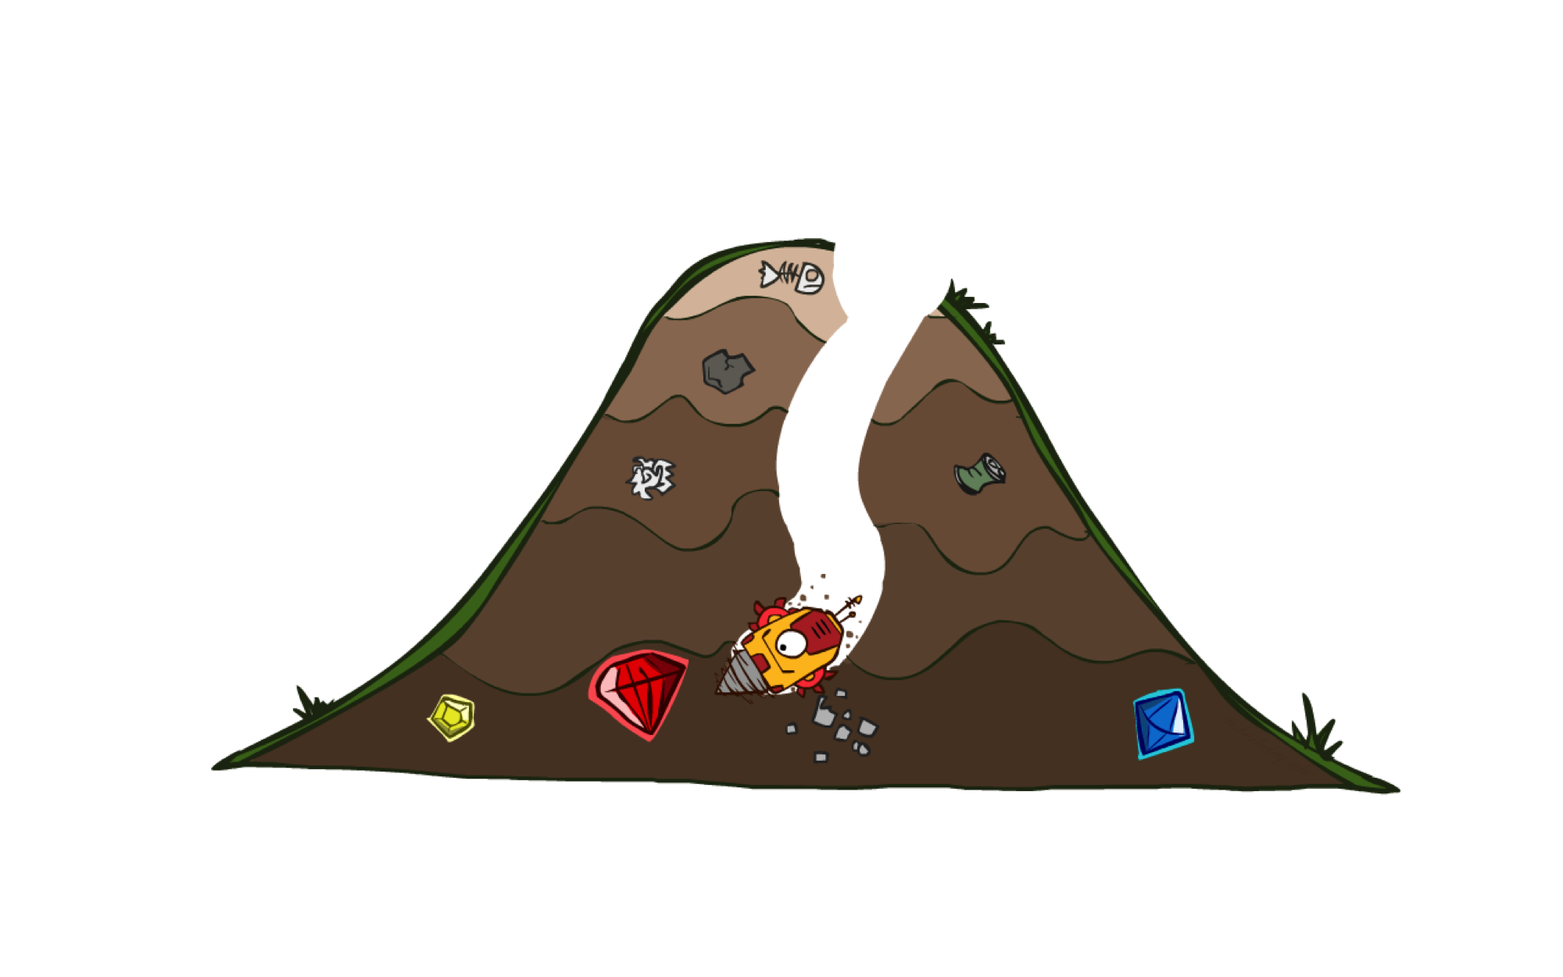
A* Search: best-first search
It evaluates nodes by combining g(n), the cost to reach the node, and h(n), the cost to get from the node to the goal

Slide 15
A*: the core idea
Expand a node n most likely to be on the optimal path
Expand a node n → the cost of the best solution through n is optimal
Expand a node n with lowest value of g(n) + h*(n)
g(n) is the cost from root to n
h*(n) is the optimal cost from n to the closest goal
We seldom know h*(n) but might have a heuristic approximation h(n)
A* = tree search with priority queue ordered by g(n) + h(n)
heuristic function:

Slide 16
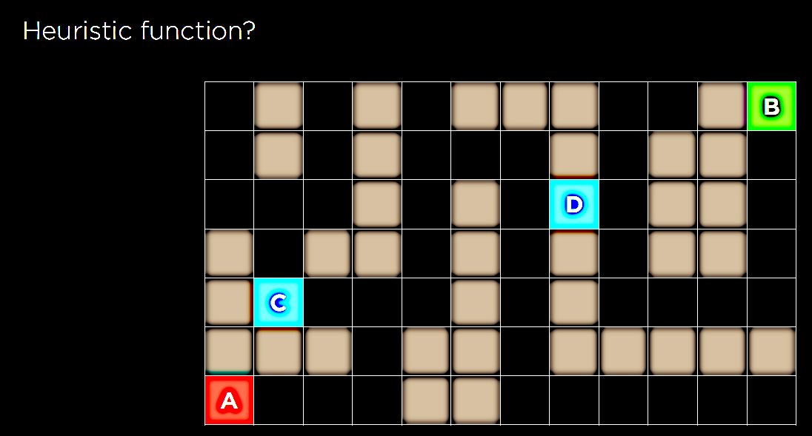

Slide 17
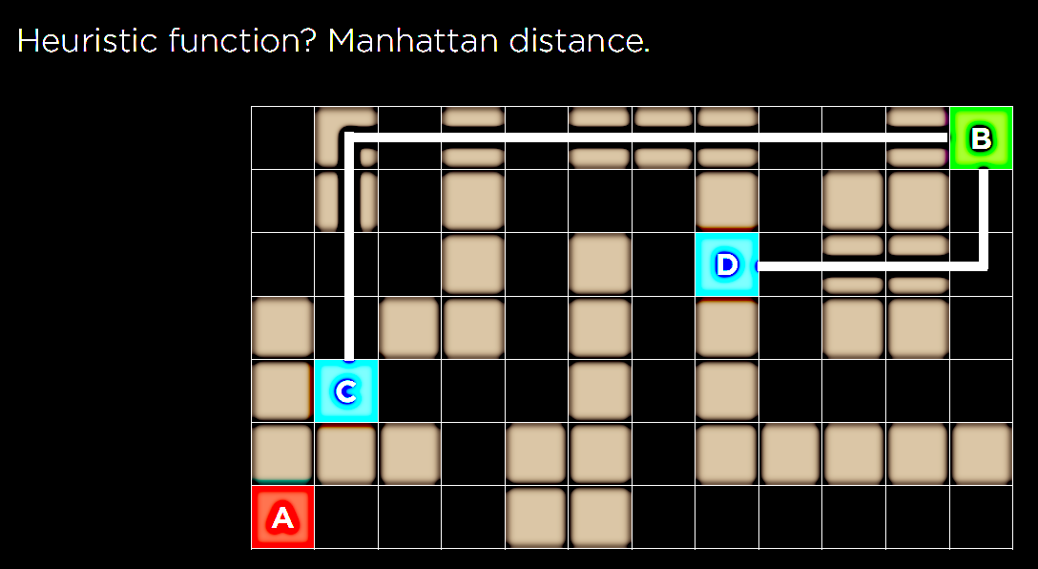

Slide 18
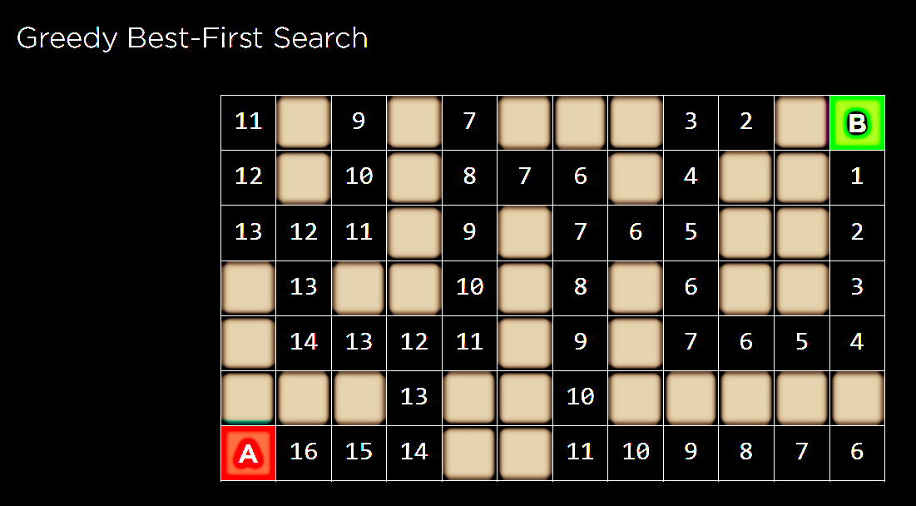

Slide 19
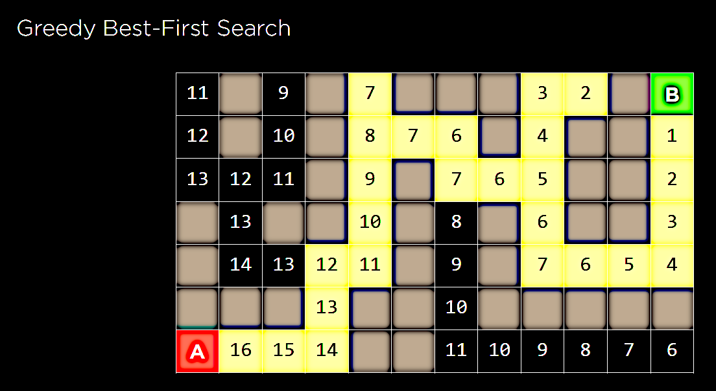

Slide 20
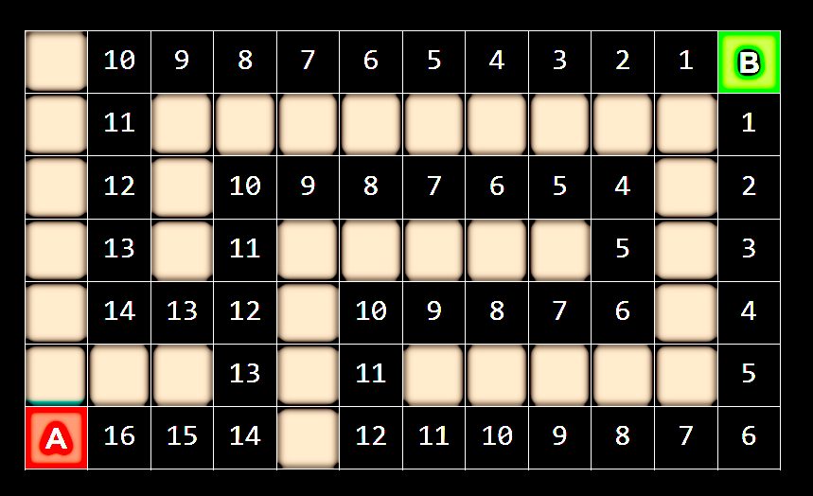

Slide 21
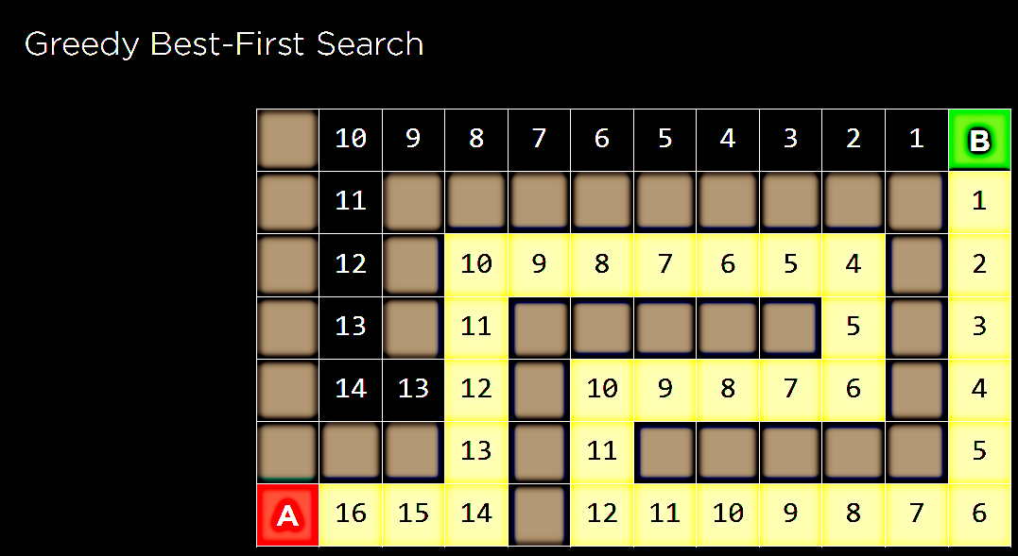

Slide 22
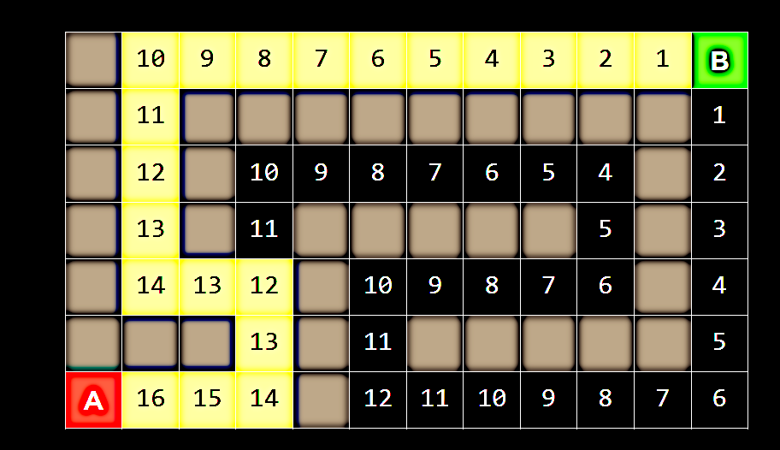

Slide 23
With A* ?!?!?
g(n) + h(n)

Slide 24
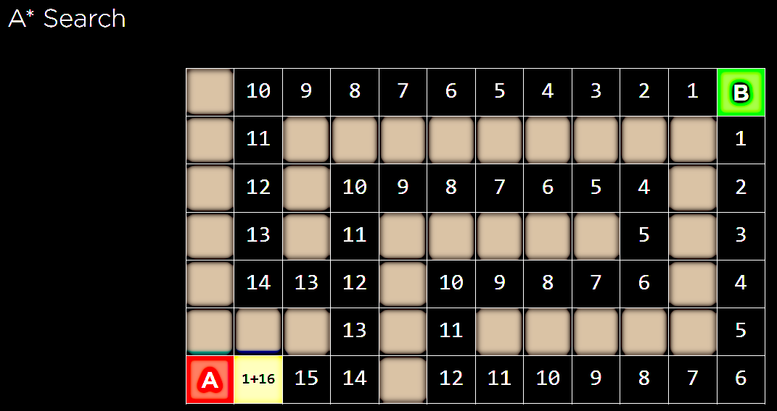

Slide 25
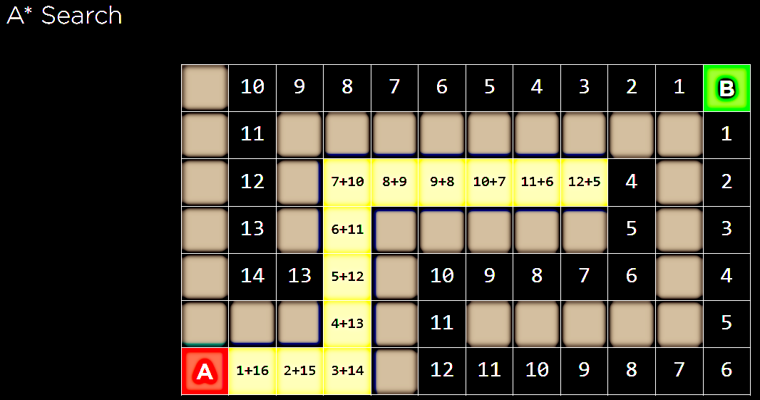
13 + 4
6 + 13

Slide 26
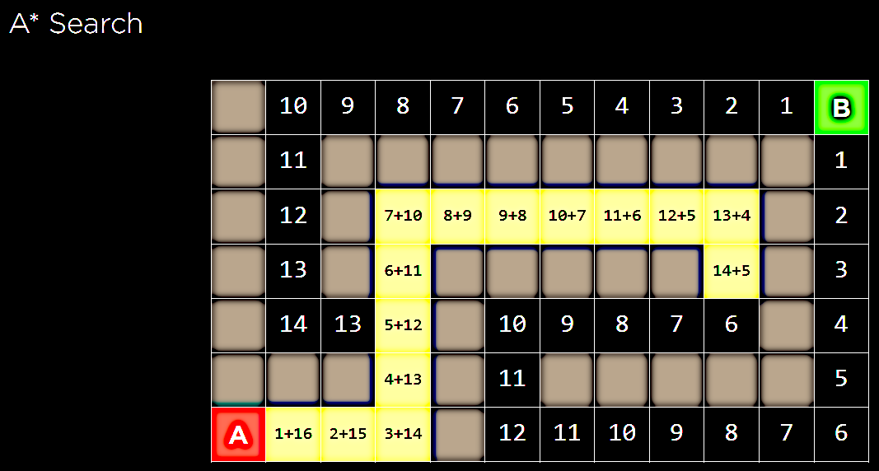
15 + 6
6 + 13

Slide 27
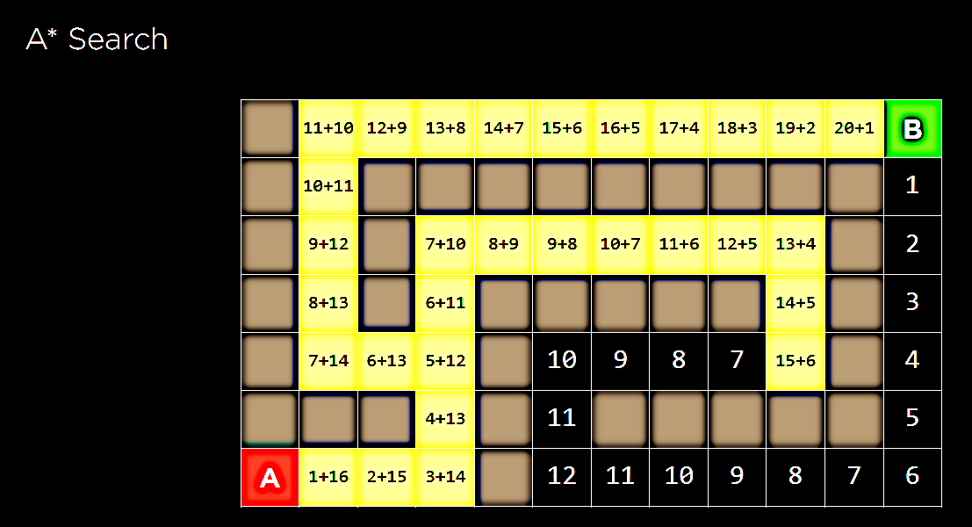

Slide 28
Is A* Optimal?
h = 6
1
A
3
S
h = 7
G
h = 0
5
What went wrong?
Actual bad solution cost < estimated good solution cost
We need estimates to be less than actual costs!

Slide 29
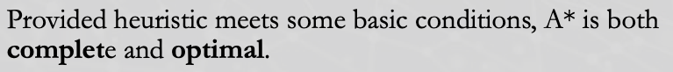

Admissible Heuristics

Slide 30

Admissible Heuristics
A heuristic h is admissible (optimistic) if:
0 ≤ h(n) ≤ h*(n)
where h*(n) is the true cost to a nearest goal
Example:
Finding good, cheap admissible heuristics is the key to success
15

Slide 31
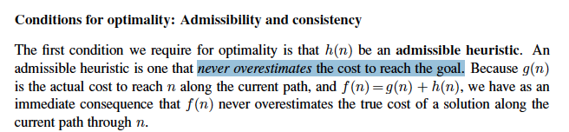

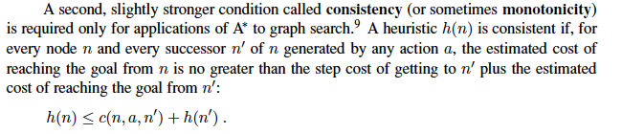
Optimality of A* Tree Search

Slide 32
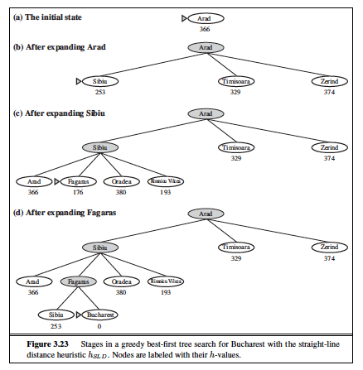
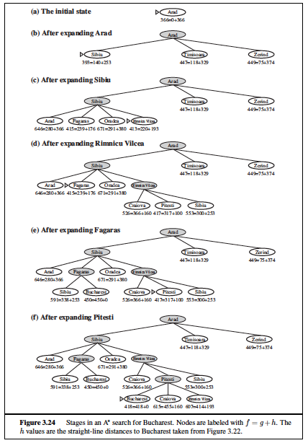
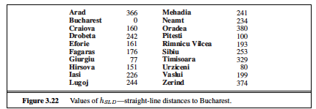

Slide 33
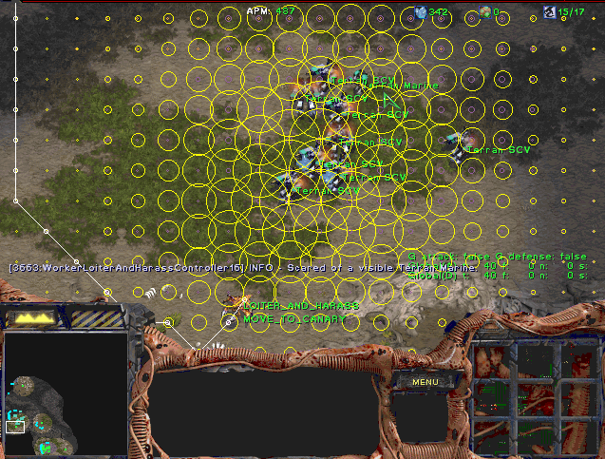
A* Applications
Video games
Pathing / routing problems
Resource planning problems
Robot motion planning
Language analysis
Machine translation
Speech recognition
Protein design
Chemical synthesis
…

Slide 34

Creating Heuristics

Slide 35
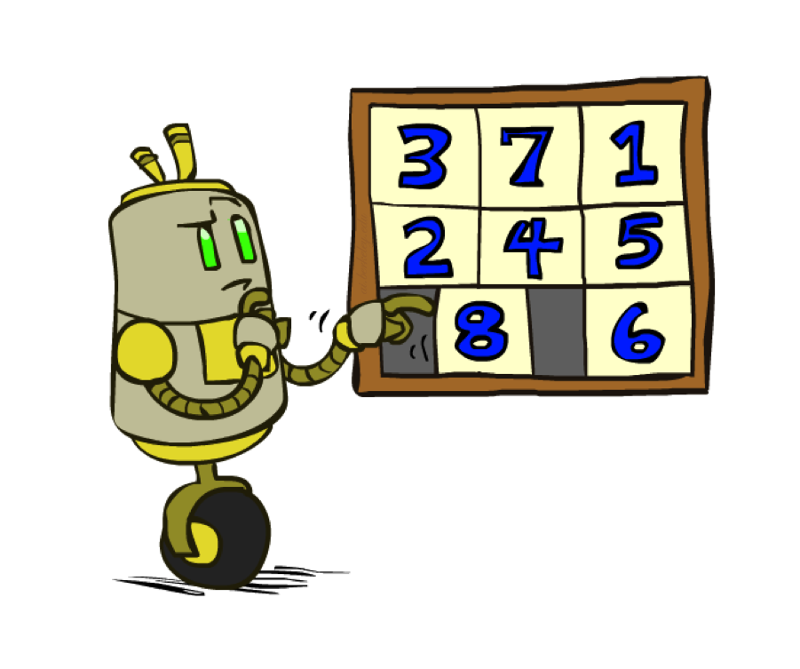
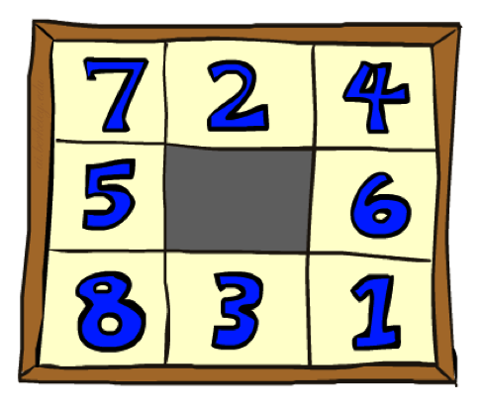
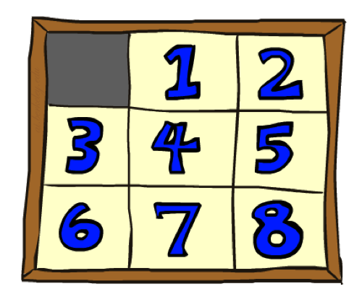
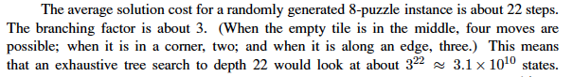
Example: 8 Puzzle
Start State
Actions
Goal State
What are the states?
How many states?
What are the actions?
What are the step costs?
Notes:
9! = 362,880 but 16! (15-puzzle) = 20 trillion, 25! = 10^25

Slide 36
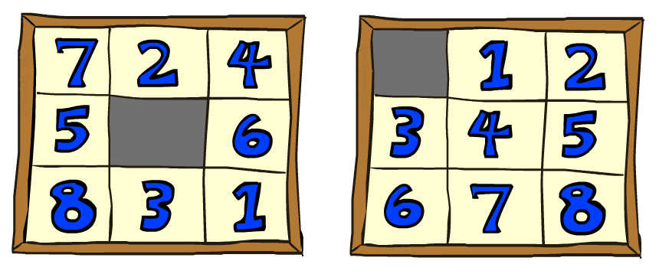

8 Puzzle I
Heuristic: Number of tiles misplaced
Why is it admissible?
h(start) =
8
Start State
Goal State

Slide 37
8 Puzzle II
What if we had an easier 8-puzzle where any tile could slide any direction at any time, ignoring other tiles?
Total Manhattan distance
Why is it admissible?
h(start) =
Start State
Goal State
 | Average nodes expanded when the optimal path has…
 | …4 steps | …8 steps | …12 steps
A*TILES | 13 | 39 | 227
A*MANHATTAN | 12 | 25 | 73
3 + 1 + 2 + … = 18

Slide 38
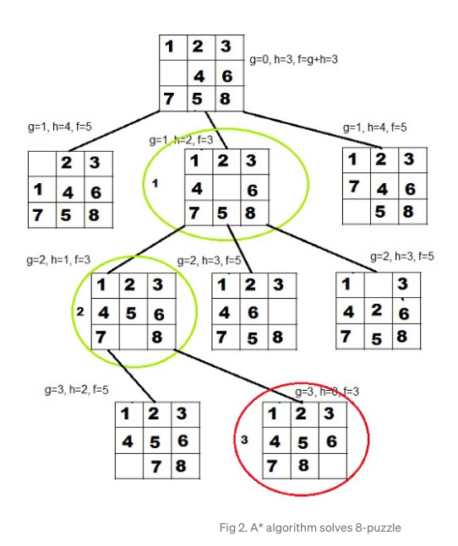
h1 = the number of misplaced tiles.

Slide 39
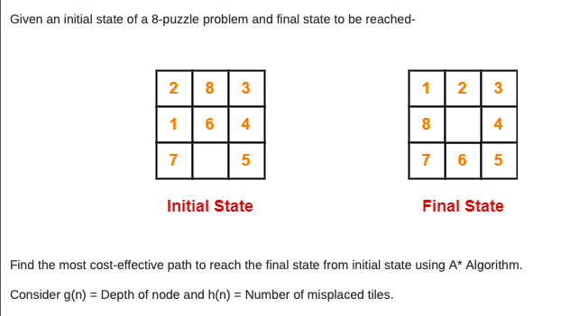

Slide 40
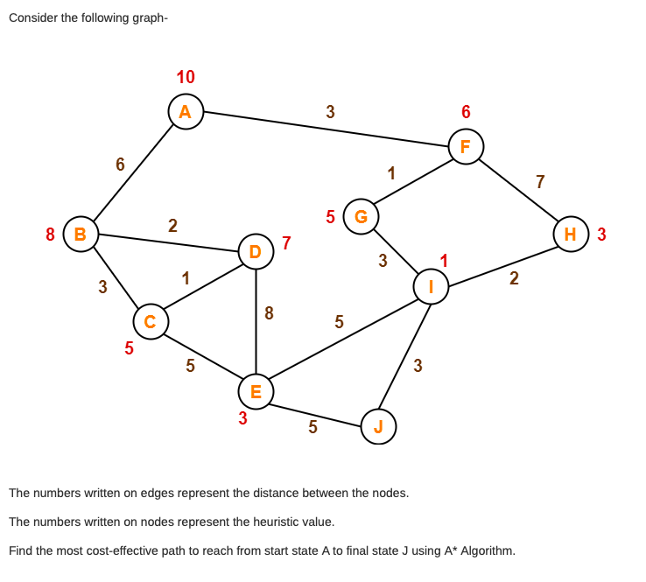

Slide 41
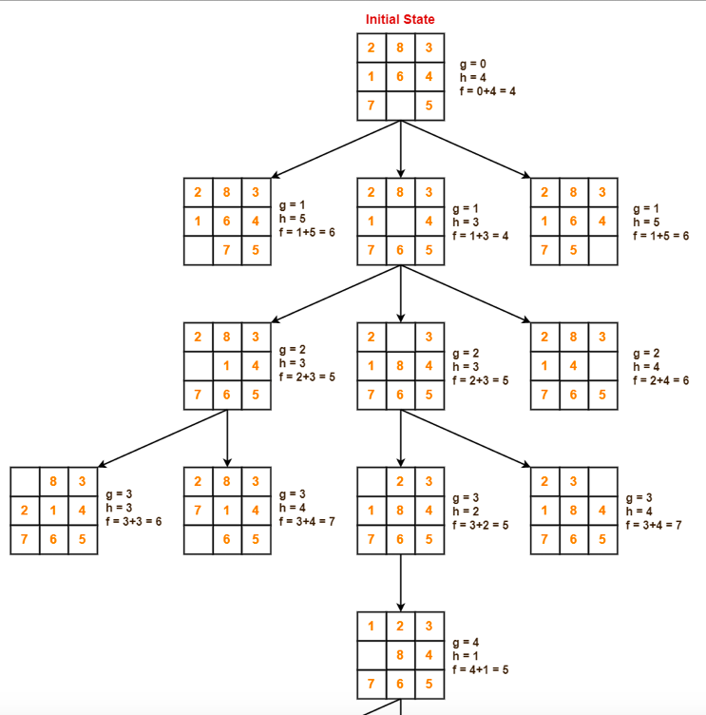
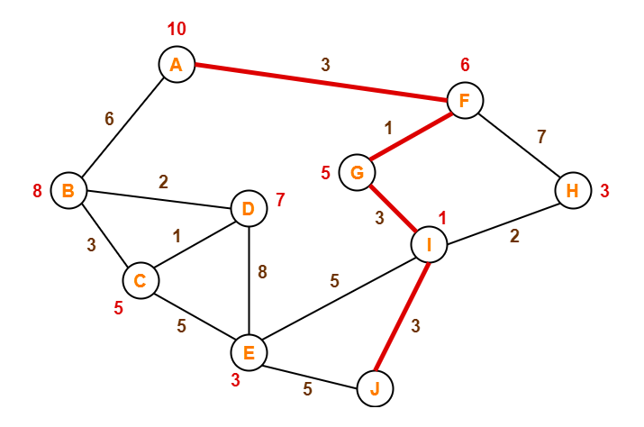
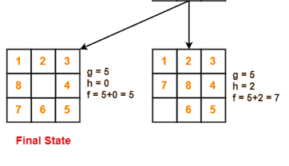
Solutions

Slide 42
Optimality
Tree search:
A* is optimal if heuristic is admissible
Graph search:
A* optimal if heuristic is consistent
Consistency implies admissibility
Most natural admissible heuristics tend to be consistent, especially if from relaxed problems

